Slide 1
ESE Semester 6
Welcome to A Fine Balance!
May 8, 2017

Slide 2
ESE S6
Subject Overview
Weekly Schedule
Policies
Brief & Debrief
Looking Ahead to Capstones
Projects Overview
Week 1 Briefing

Slide 3
ESE S6: Subjects
Datacomm & Networks (Michael Galle)
Advanced Topics in Math (Ali Tehrani)
Natural Sciences (Tina Avolio)
Software Engineering (Michael Galle)
Thermodynamics (MSE faculty)
  Lab (alternating Tuesdays)
Project (Michael, Ali)
May be a Liberal Studies Elective

Slide 4
ESE S6: Schedule
Most courses are 60 hours in length
  Usually be 2 2-hour sessions per week
  Exceptions:
    Thermo. 2+1+1 lab
There are 2 Monday holidays and 1 Friday holiday
  “make-up” blocks available on Thursday (also time elsewhere)
Quizzes, when scheduled, refer to instructional plan

Slide 5
ESE S6: Brief & Debrief
BRIEFING: 3:00-3:30 Monday
BRIEFING: 3:30-5:00 Monday
OTHER SCHEDULED TIME: 2:00 Friday (proposing to move it to Mon 1:00-3:00)
We may also need time for "Special Topics"
  These, when scheduled, are mandatory!
  They will include specific topics for the Project
  This is likely to be Friday’s at 2pm

Slide 6
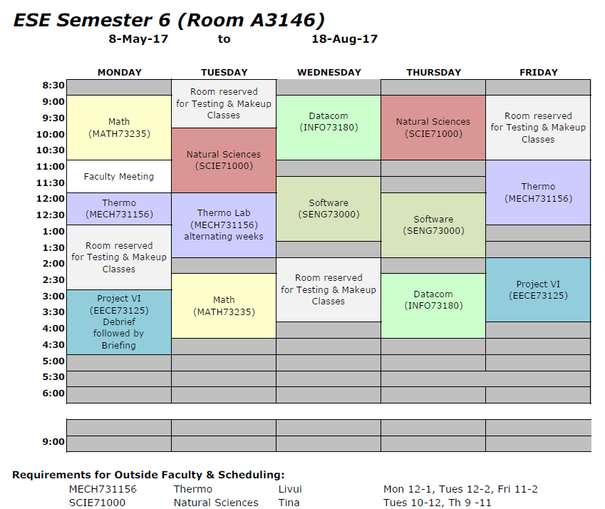
ESE S6: Schedule

Slide 7
Policies
Late
  Depends on the Prof
Incomplete depends on
  Marks
  Attendance
  Submissions
PLEASE do not push these limits. The summer is tough enough without it dragging on!

Slide 8
Exams and Mid-Terms
Final exams are typically in week 15
As much as possible we try to keep exams on the same day as one of the lectures for subject
For Midterm exams TBD

Slide 9
ESE S6: Year 4 Capstone
NEW We require an approved topic proposal (1-2 pages) before the end of this semester
  Proposals are not necessarily accepted!
A detailed proposal and a risk analysis will be due at the end of week 4 in September
Project plan due the first week of S7
Therefore you should be looking for capstone opportunities all through this semester

Slide 10
ESE S6: S6 Projects
Michael and Ali will lead the projects
Single project theme, with 3 project stages
The first briefing today at 2:00

Slide 11
Now to Begin . . .
Any questions?

